Slide 1

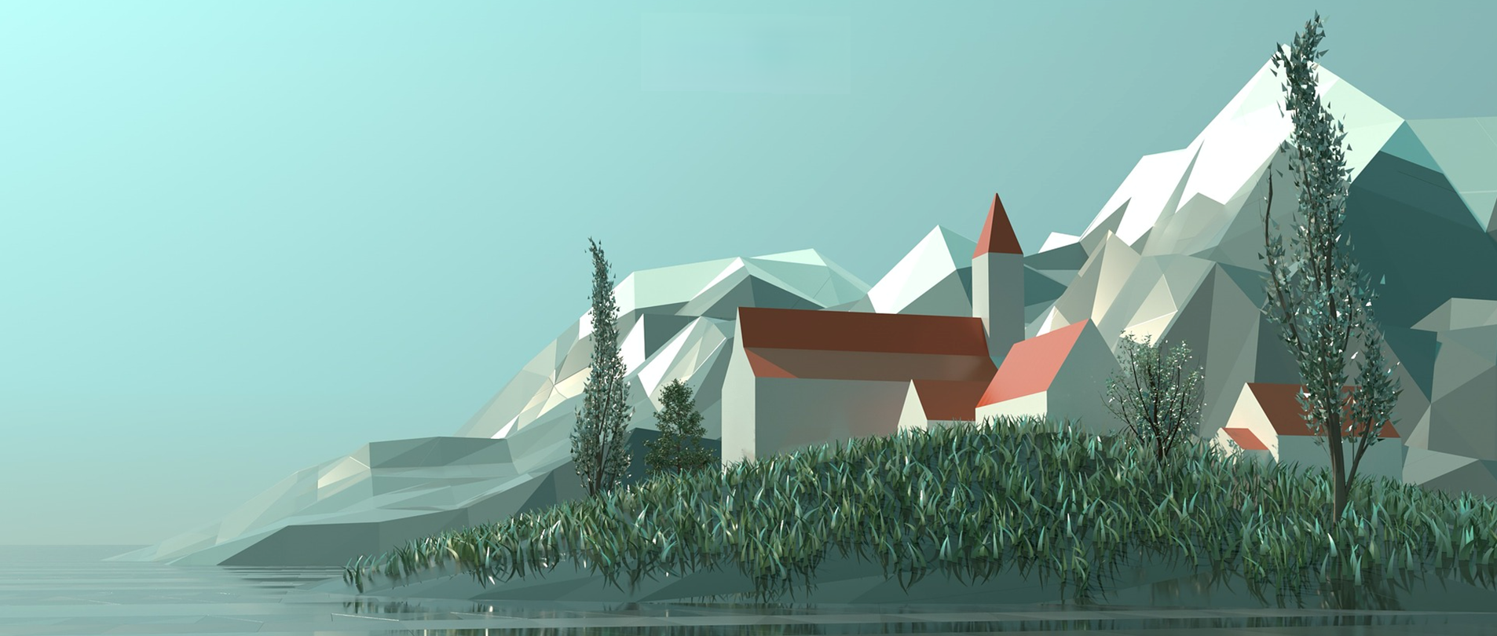

Large-scale scene simulation of games in cold-temperate deciduous coniferous forest area based on UE
Zhiyuan Wang
QM No.190017767
BUPT No. 2018212993
Notes:
尊敬的老师，上午好!
我是王致远,我的毕业论文题目是《Large-scale scene simulation of games in cold-temperate deciduous coniferous forest area based on UE》,接下来由我为大家带来毕设演讲
在开始演讲之前，我想邀请各位老师看一段演示视频。
Dear teacher, good morning!
My name is Wang Zhiyuan. And My project title is "Large-scale scene simulation of games in cold-temperate deciduous coniferous forest area based on UE".
Before starting the presentation, I would like to invite you to watch a demonstration video.

Slide 2
Presentation Video

Slide 3




Background
Next-Gen Game
Cold temperate zone
Next-generation games refer to games that are more advanced than similar games.
China's game market will reach 278.6 billion in 2020
Long and cold winters, short warm summers
The representative of the cold temperate zone in China, the Greater Khingan Mountains, mainly studies the mixed forest of coniferous and broad-leaved in the cold zone.
Unreal Engine
Procedural Content
Generation
The Chinese game market lacks a 3D environment construction process integrated into the game engine.
Through the program scene design module of unreal engine, this study constructed a complete automatic blueprint of cold zone and established a perfect vegetation covers.
Procedural Generation (PCG)
An area is automatically generated using the laws of physical geography, which is the basis of open world games.
PCG is one of the core technologies of next-generation games.
Notes:
All right，首先我要简单介绍一下项目背景。这将分为4个块部分：
All right, first I would like to briefly introduce the background of the project. This will be divided into 4 sections:
First Part——The Next-Gen Game
次世代游戏指和同类游戏相比下更加先进的游戏，即下一代游戏。
Next-generation games refer to games that are more advanced than similar games.
Second Part——Cold temperate zone
本文所研究对象为中国寒温带代表——大兴安岭，主要研究针阔叶混交林的仿生研究，还原植物种类、分布模式与季节变化。
The research object of this paper is Greater Khingan Mountain, a representative of China's cold temperate zone. It mainly studies the bionic research of mixed forest, and restores the plant species, distribution mode and seasonal change
Third Part——Procedural Content Generation
程序化生成技术（PCG）中已经运用了自然地理学地形地貌规律自动生成一个地区的地形地貌，这是开放世界游戏的基础。
PCG是次时代游戏的核心技术之一。
The procedural content generation has used the topography(topa!graphy) laws of physical geography to automatically generate a region, which is one of the core technologies of next-generation games.
中国游戏市场缺少集成到游戏引擎中的3D环境构造流程。
本研究通过unreal的程序场景设计模块，构造了完整的寒带自动蓝图。工作将为未来中国背景的游戏设计提供基础工具。
The Chinese game market lacks a 3D environment construction process integrated into the game engine.
In this study, a complete cold zone automatic blueprint is constructed. The work will provide the basic tools for future game design in the Chinese context.

Slide 4
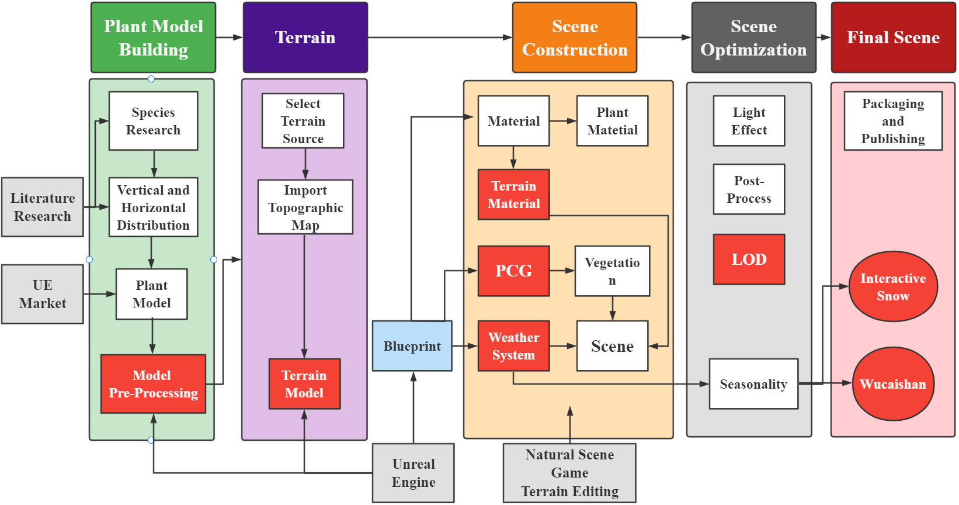
Research Flow Chart
Figure 3.1 Research flow chart
Notes:
这里是我的研究流程图，可以看到，上面的5个Part代表着本研究最重要的5个部分，也是本次演讲的顺序。其中红色的部分代表着重要的环节。
Here is my research flow chart. As you can see, the 5 Parts above represent the 5 most important parts of this research and they are also the sequence of this presentation.
The red parts represent important sections.

Slide 5
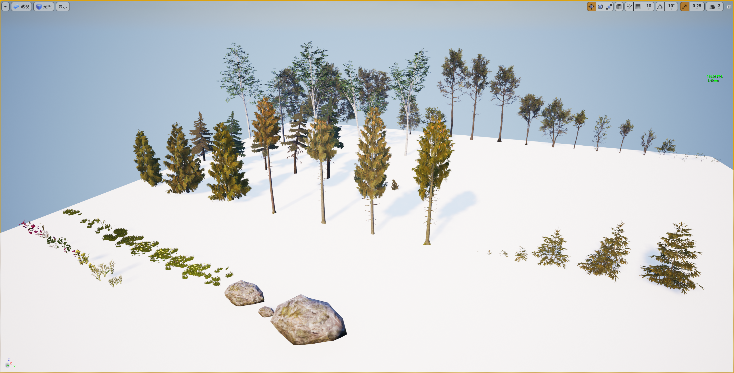
Plant Model Building
Figure 4.1 Schematic diagram of all assets
Notes:
Now let's get to the first part –Plant Model Building
内蒙古大兴安岭以北的原始森林区保存最完好，是中国唯一一个集中连片、未开发面积最大的原始森林；
The primeval(praimi!vol) forest area in the north of Greater Khingan Mountain, Inner Mongolia is the best preserved, the only contiguous primeval forest with the largest undeveloped area in China;

Slide 6
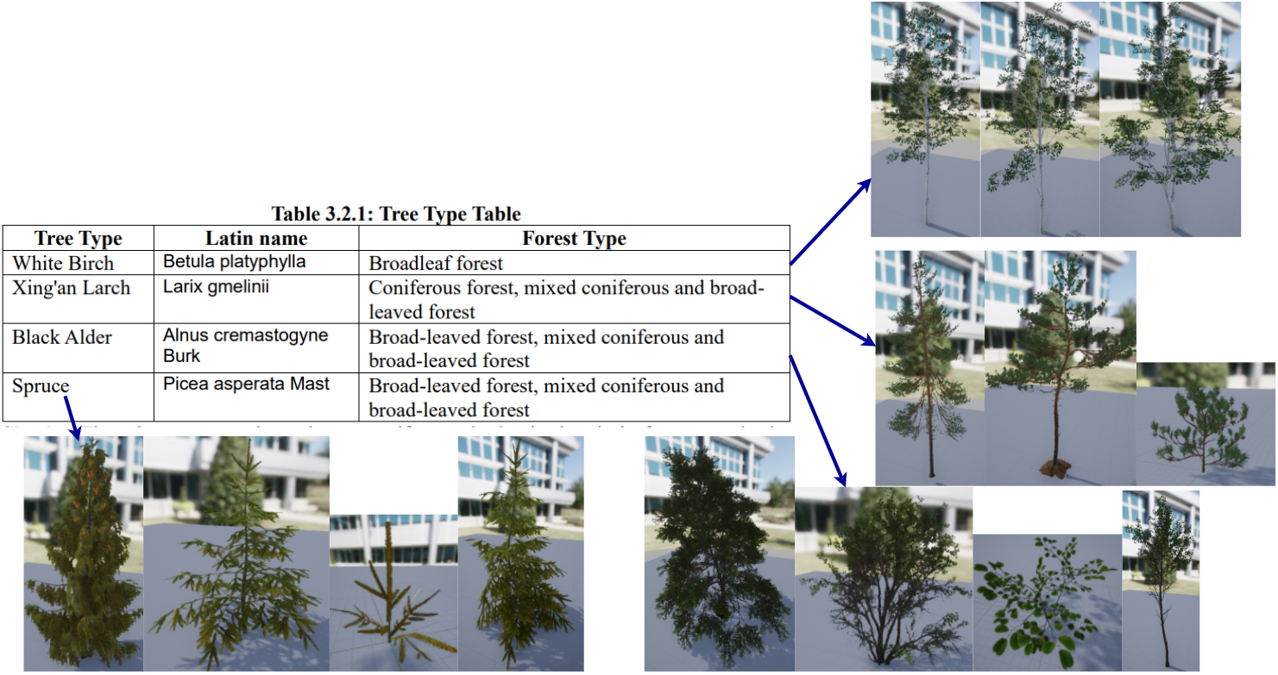
Plant Model Building-Forest
Forest: Three vegetation subtypes
Coniferous forest: Xing’an larch forest
Coniferous and broad-leaved mixed forest: the mixed forest of Xing’an larch and white birch is only the transitional vegetation type in this area.
Broad leaved forest:
white birch forest, and small-area black alder forest.
Figure 5.1 Tree table
Notes:
Then let’s take a look of the Forest
森林：根据植物组成、结构、外貌等特征,本区可划分3个植被亚型,即:针叶林、针阔叶混交林、阔叶林。
针叶林：针叶林为主要由兴安落叶松构成。
针阔叶混交林：主要由兴安落叶松、白桦林混交林构成。仅是一种过渡植被类型,具有不稳定性。
阔叶林：阔叶林在树种组成上极单纯,分布最普遍是白桦林, 其他有小面积的黑桦林。
According to the characteristics of plant composition, structure and appearance, this area can be divided into 3 subtypes, they are
Coniferous forest: which is mainly composed of Xing'an larch.
Coniferous and broad-leaved mixed forest: It is mainly composed of mixed forest of Xing'an larch and birch forest. It is only a transitional vegetation type so it is unstable.
Broad-leaved forest: which is extremely simple in terms of tree species. The most common distribution is the birch forest

Slide 7
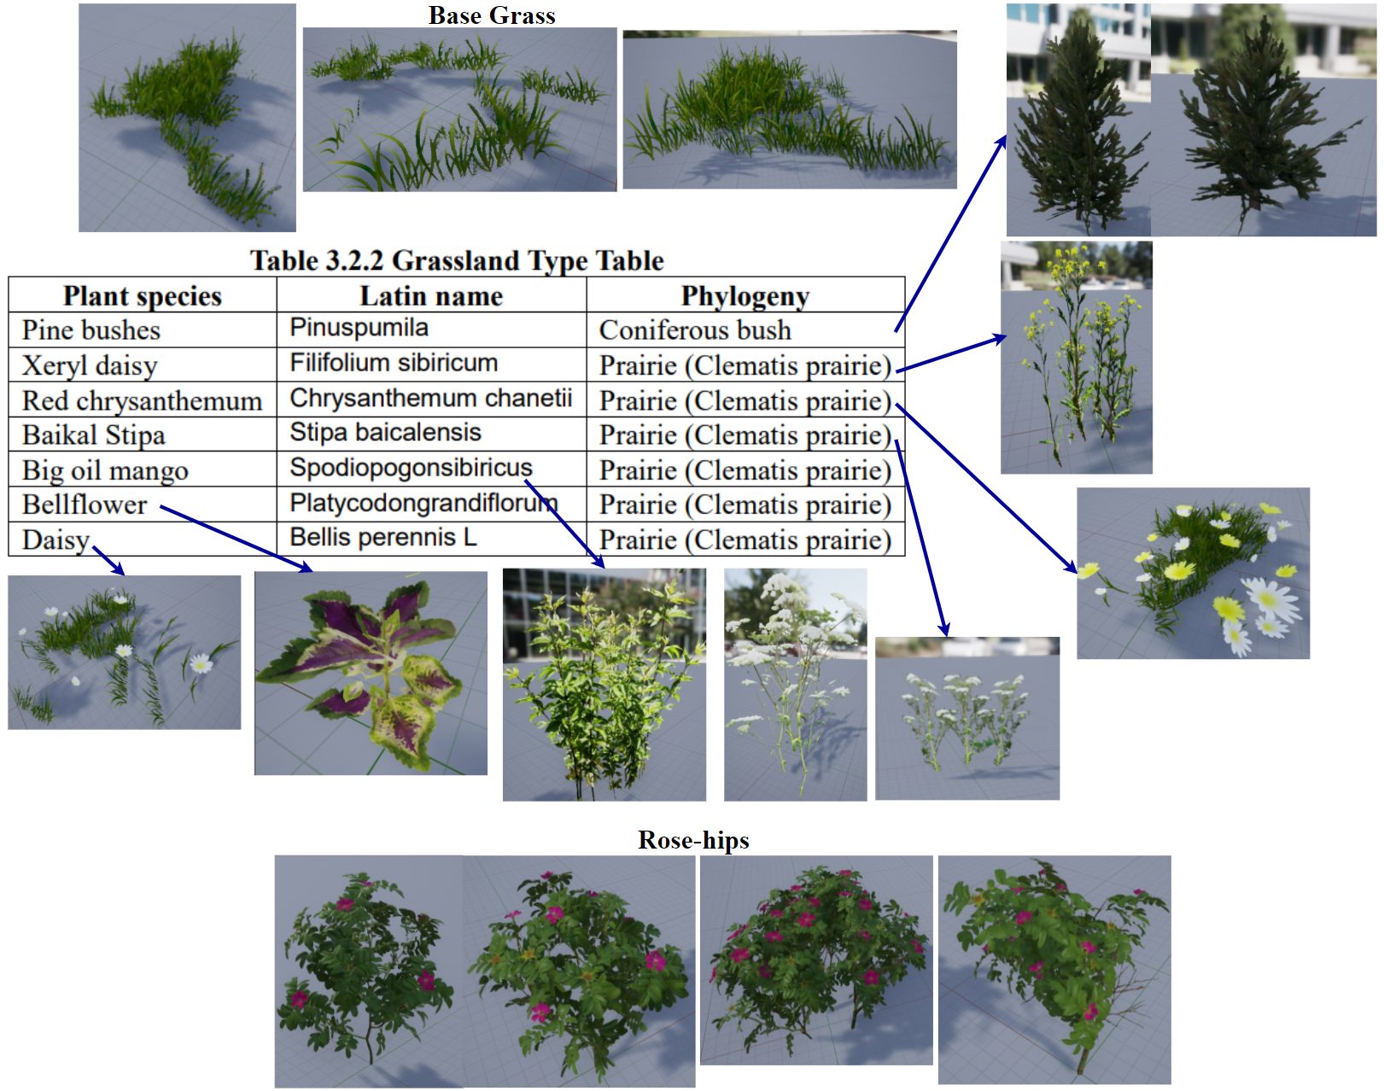
Plant Model Building -Grassland
Shrub: Coniferous shrub, including 2 clusters: thinopyrus shrub and Xing'an juniper shrub.
Grassland: thread leaf chrysanthemum grassland, Xing'an thyme grassland
Figure 6.1 Grassland table
Notes:
About the Grassland
灌丛：大兴安岭北部原始林区灌丛拥有许多植被，以pine bushes为主。
草原：经查找资料，选取了本区草原上有代表性的数种植物，以Xeryl Daisy为主的草原包含树种菊科植物
The shrubs in the primeval forest area in the northern part of the Greater Khingan Mountains have a lot of vegetation, mainly pine bushes.
After searching for information, several representative plants on the grasslands in this area were selected.

Slide 8
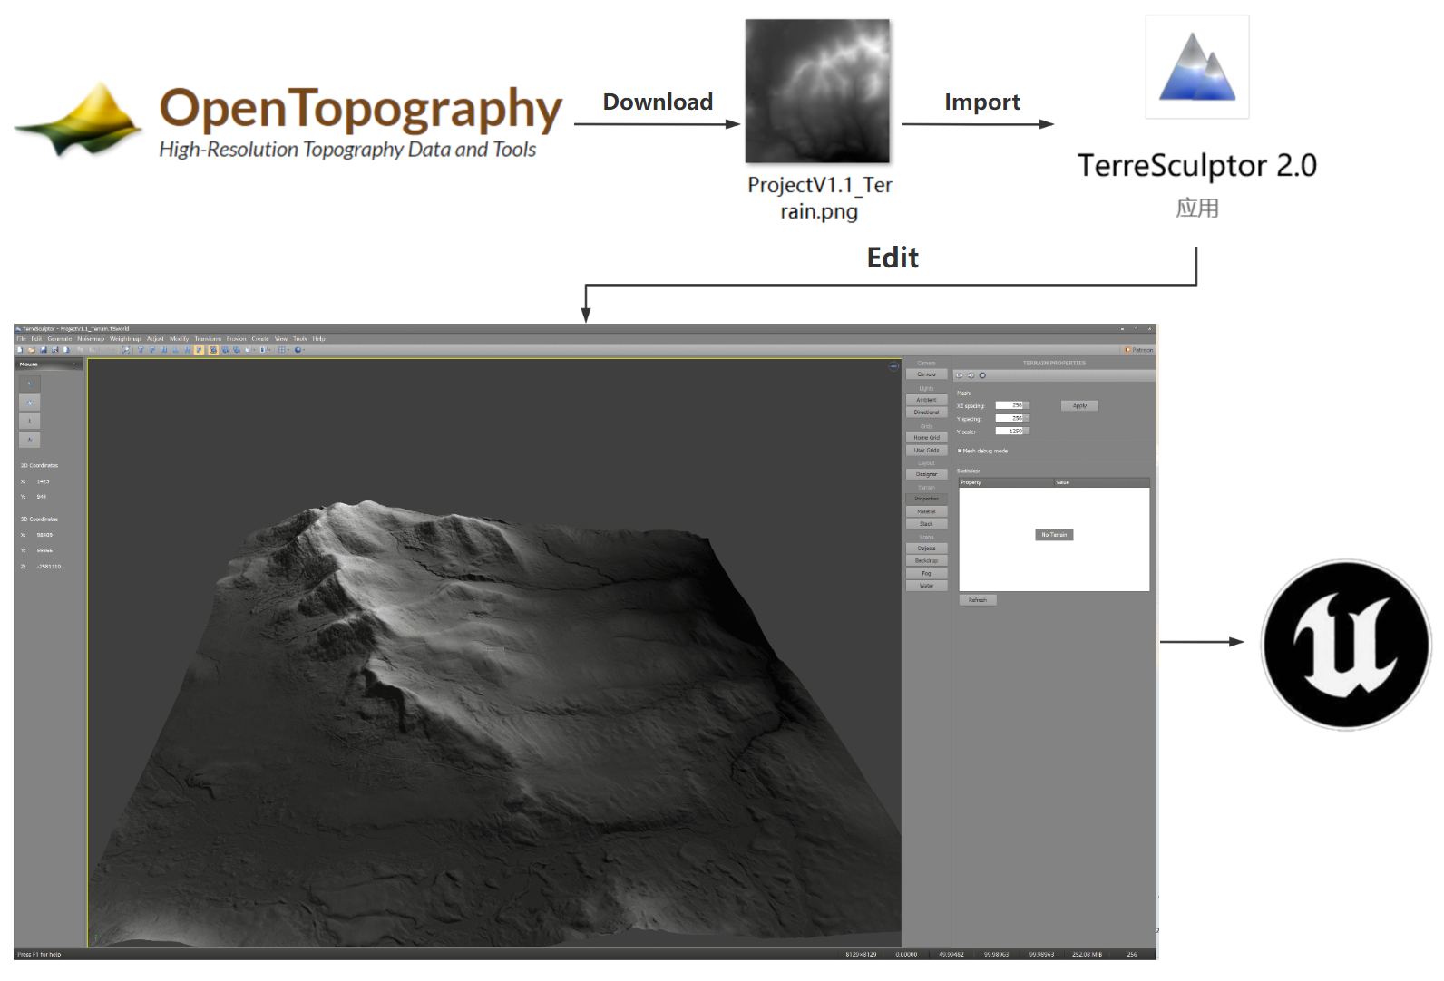
Landscape
Terrain elevation
Information points with elevation values - peaks, saddles and valleys, rivers, roads
Terrain selection
The size of the terrain: the corresponding real map is 8129m*8129m. Use Google Earth to do a terrain search.
The terrain is mostly gentle with slopes and is easy to stratify vegetation, including mountains, plains and two rivers.
Real terrain altitude source
Accuracy takes precedence. When selecting an elevation source, exclude sources based on the principle of precision first.
Topographic elevation map processing
The downloaded .geotiff file cannot be directly imported into UE, which requires preprocessing of the downloaded terrain elevation map. TerreSculptor software was used in this study, and the final output was 16-bit grayscale output (16-bit grayscale) to generate .png files.
Figure 7.1 Terrain Generation Flowchart
Notes:
Now we come to the second part, Landscape
地形高程图
高程点即标有高程数值的信息点，高程点分布表达上具有丰富的特征，如山峰、鞍部及山谷、河流、道路
First Terrain elevation
Elevation points are information points marked with elevation values. The distribution expression of elevation points has rich characteristics, such as peaks, saddles and rivers.
地区地形选择
在项目开始阶段需要考虑到地形的合适大小;
过大的地形承载的内容也会更多，而大量内容会导致引擎的负荷增大，
Then, It is really important to select a terrain
At the beginning of the project, the appropriate size of the terrain needs to be considered;
Excessive terrain will carry more content, and a large amount of content will increase the load on the engine.
真实地形高程源
选择高程源时以精度优先的原则排除来源，精度高代表地形地貌效果更好
The principle of searching the real terrain altitude source is accuracy first.
High accuracy means better terrain and landform effect
地形高程图处理
对于下载的.geotiff文件，并不能直接导入UE中。本研究使用TerreSculptor软件，经过调整后生成.png文件。
Finally, the file preprocessing is essential.
The downloaded .geotiff file cannot be directly imported into UE. Teresculptor is used to modify the original file and finally generated a PNG file.

Slide 9
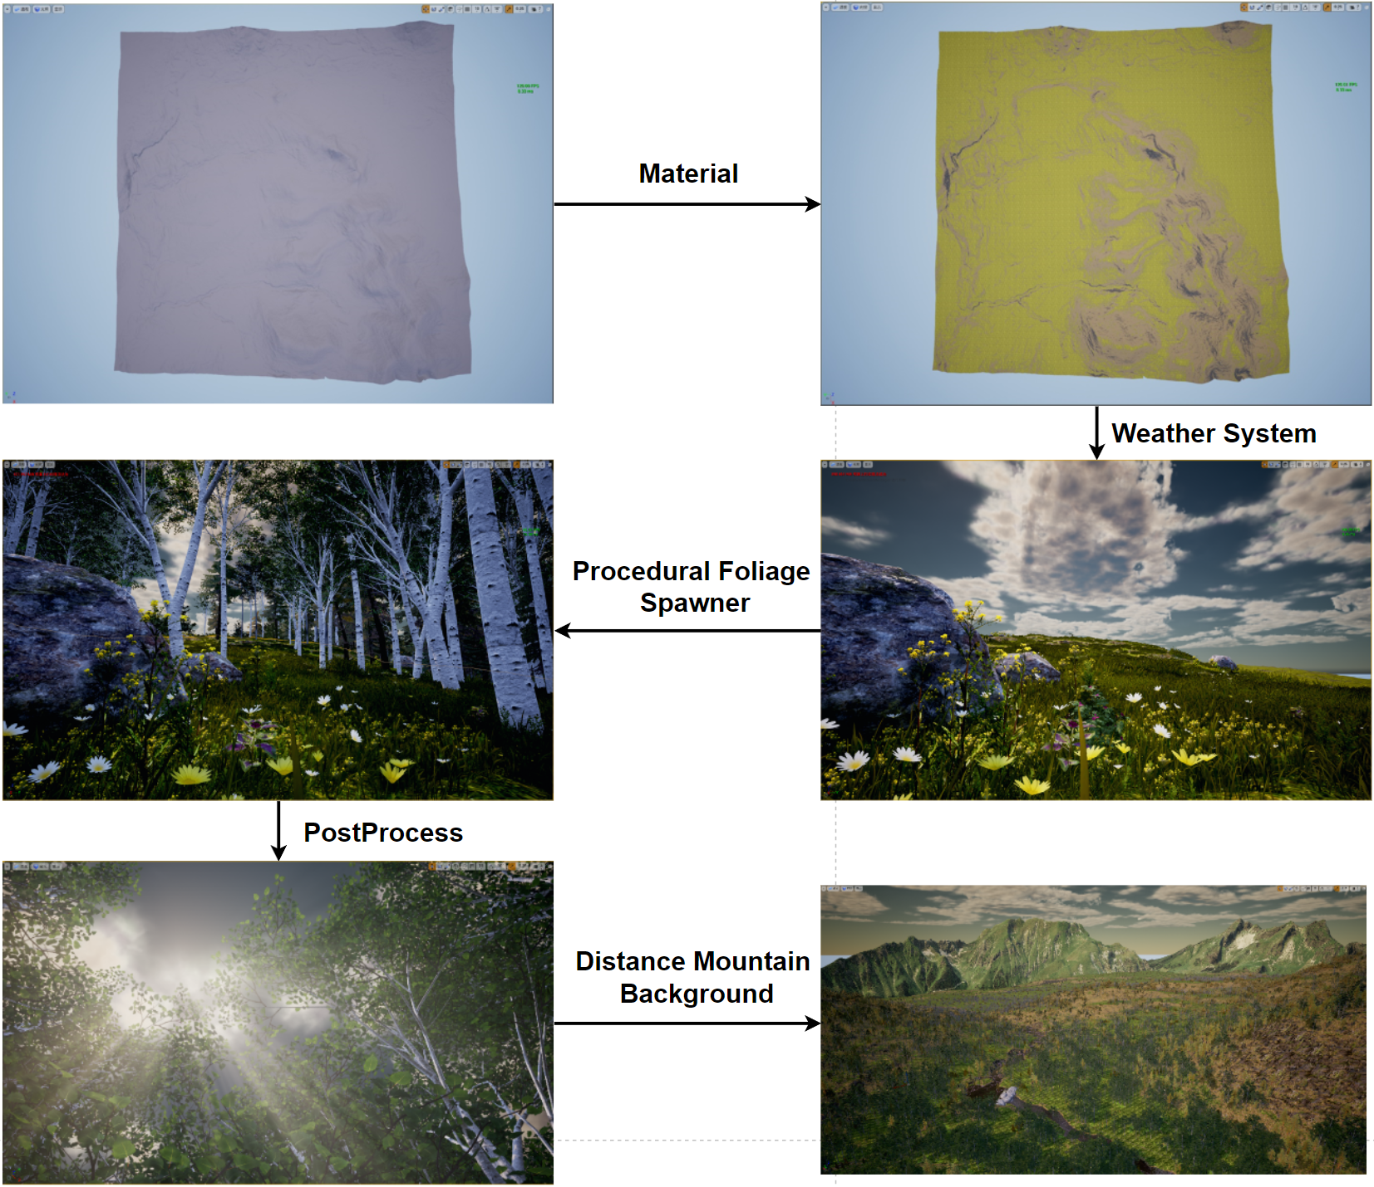
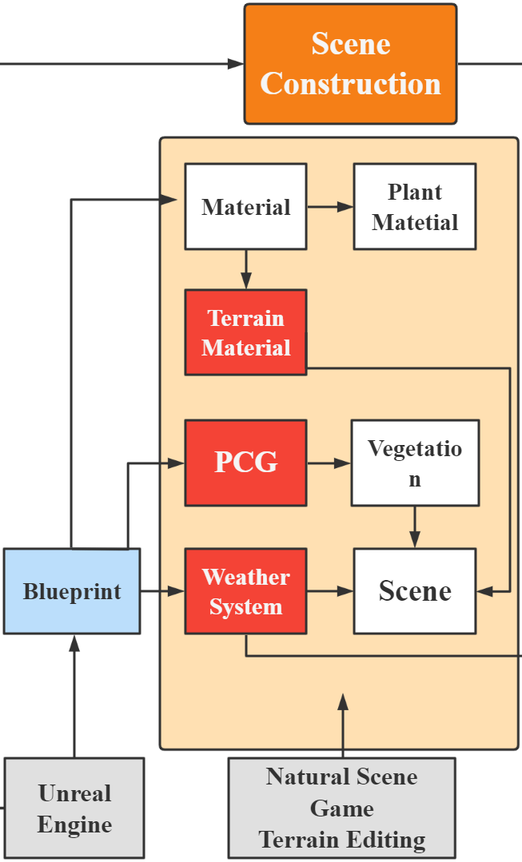
Scene Construction
Figure 8.2 Scene construction flow chart
Figure 8.1 Scene structure example
Notes:
After selecting the plants and terrain, now comes to the third part – Scene Construction, this is also the hardest part of the project.

Slide 10
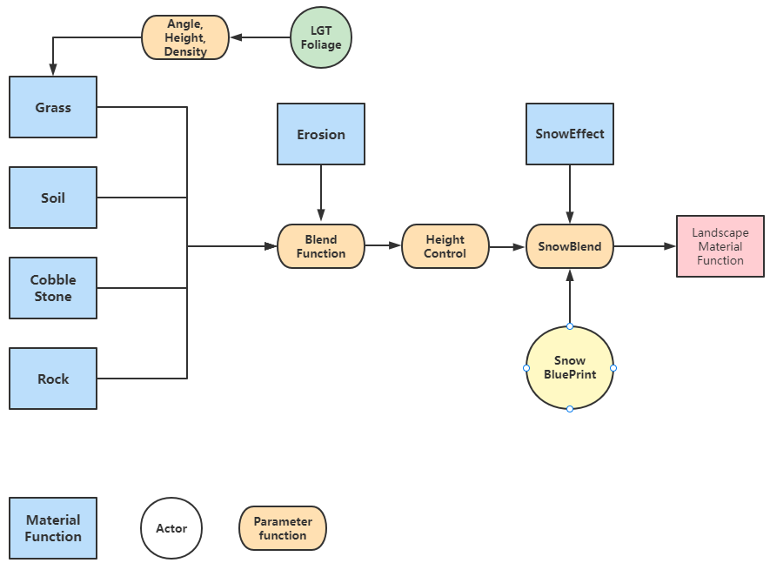
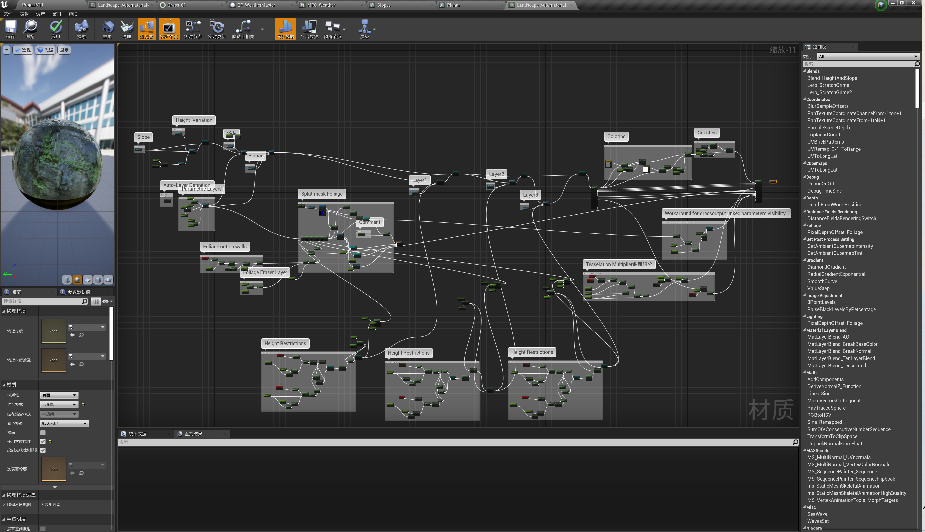
Difficulties in scene construction - Terrain material function
Figure 9.2 Landscape Material Function panel in White Birch
Figure 9.1 Landscape Material Function panel in White Birch
Notes:
材质（Material）分层，共6层
Planar负责生成草地与泥土，Slope负责生成鹅卵石，Side负责生成Cliff。
Caustics侵蚀层，负责为自动生成的材质赋予雨水侵蚀效果，更加接近真实地貌。
SnowBlend层混合了雪材质至所有图层上。
Now let me introduce the Landscape Material Function,
This material has in total of 6 layers
Planar is responsible for generating grass and dirt, Slope is for generating pebbles, and Side is for generating Cliff.
The Caustics erosion layer is responsible for giving the automatically generated material a rain erosion effect, which is closer to the real landscape.
The SnowBlend layer blends the snow material onto all layers.

Slide 11
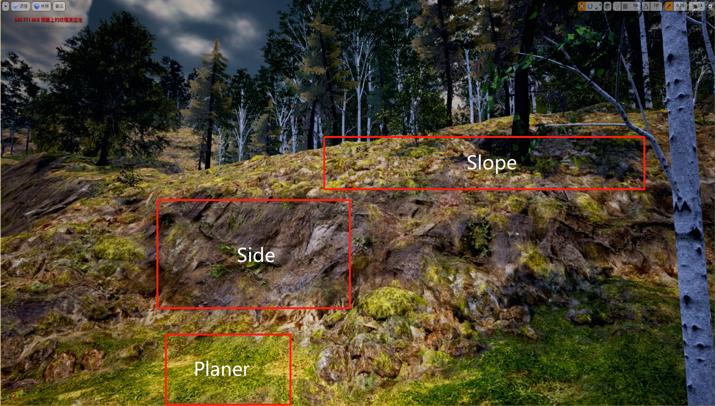
Difficulties in scene construction - Terrain material function
Figure 10.1 Terrain material layering
Notes:
三种材质生成的角度不同，但在交界处会有平滑的混合。例如Planar负责生成草地的材质, 生成于坡度小于10度平地。在10度到15度之间与Slope层有混合。
最后使用Auto图层混合了所有图层，设置数个参数用来调节自动生成效果，包括混合强度，混合距离，生成坡度，植物生长坡度。
同时此图层控制各个图层间的混合距离与混合强度。对材质添加Perlin噪声以避免远距离下的草地贴图重复问题。(and set several parameters to adjust the automatic generation effect, including the mixing strength, mixing distance, generation slope, and plant growth slope.At the same time, this layer controls the blending distance and blending strength between each layer. Added Perlin noise to materials to avoid grass map duplication issues at long distances.)
The three materials generate different angles, but will have a smooth blend at the junction.
For example, Planar is responsible for generating grass materials, which are generated on flat land with a slope of less than 10 degrees. There is blending with the Slope layer between 10 and 15 degrees.
Finally, use the Auto layer to mix all the layers.

Slide 12
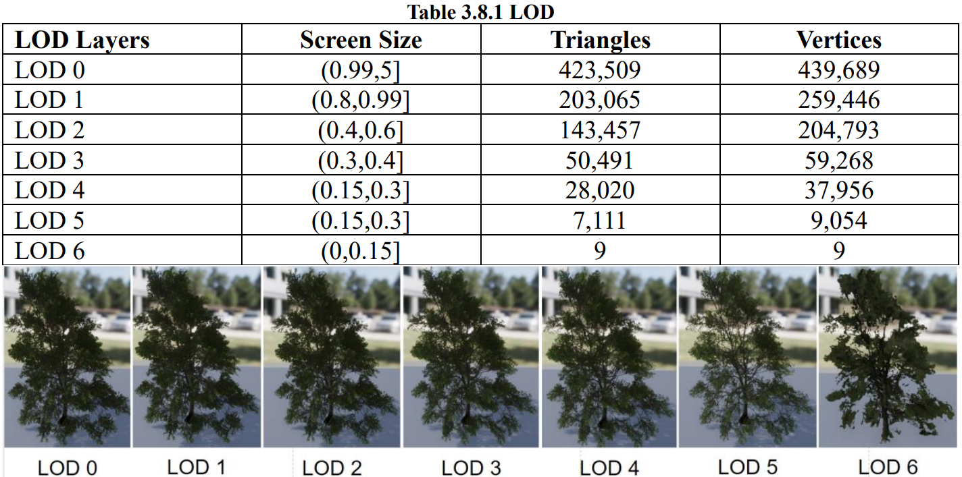
Scene optimization-LOD
LOD technology refers to determining the resource allocation of scene rendering according to the position and importance of the nodes of the object model in the display scene, so as to obtain efficient rendering operations.
LOD stands for
Level Of Detail
Figure 11.1 LOD
Notes:
场景性能优化是整个项目的重中之重，也是项目的重点部分。
在UE中，在同一场景中大量使用昂贵的植物资产会使得场景FPS（frame per second）变得非常低，
使用几种有效的优化手段稳定帧数在30fps以上，保证基本的场景浏览体验。
Scene performance optimization is a key part of the entire project.
In UE, using a lot of expensive plant assets in the same scene can make the scene FPS extremely low,
Using several effective optimization methods to stabilize the frame rate above 30fps and ensure the basic scene browsing experience
LOD
在规划场景模型时以减少图形的计算量为原则，
场景内的植物模型要根据近景、中景和远景来进行分级规划，在近景中出现的模型需要采用高精度模型，远景采用低模。
First method，LOD
When planning the scene model, the principle is to reduce the amount of calculation of graphics.
The plant models in the scene should be hierarchically planned. The model that appears in the close-range needs to use a high-precision model, and in the long-range uses a low-poly model.

Slide 13
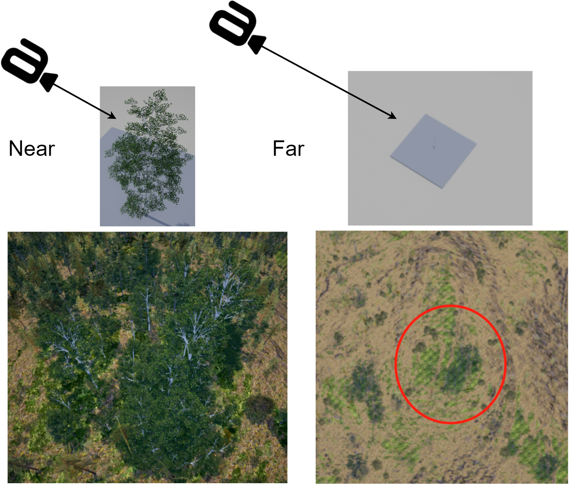
Scene optimization- Cull distance
When the camera is far enough away from a mesh component, the mesh component can be considered unimportant and therefore culled.
Mesh components are automatically culled from the scene after a certain distance from the camera, saving computational performance.
The mesh starts to cull gradually when it reaches the start culling distance, and completely culls when it reaches the end culling distance of 0, resulting in a smooth scene gradient effect.
Figure 12.1 Cull Distance
Notes:
Second Method, Cull Distance
当摄像机距离网格体组件足够远时，此时该网格体组件可以被视为不重要，从而剔除。
When the camera is far enough away from a mesh component, the mesh component can be considered unimportant and therefore culled.
通过设置Cull Distance，网格体组件会在距离镜头一定距离后自动从场景中剔除，从而节省计算性能。
By setting Cull Distance, mesh components are automatically culled from the scene after a certain distance from the camera, saving computational performance.

Slide 14
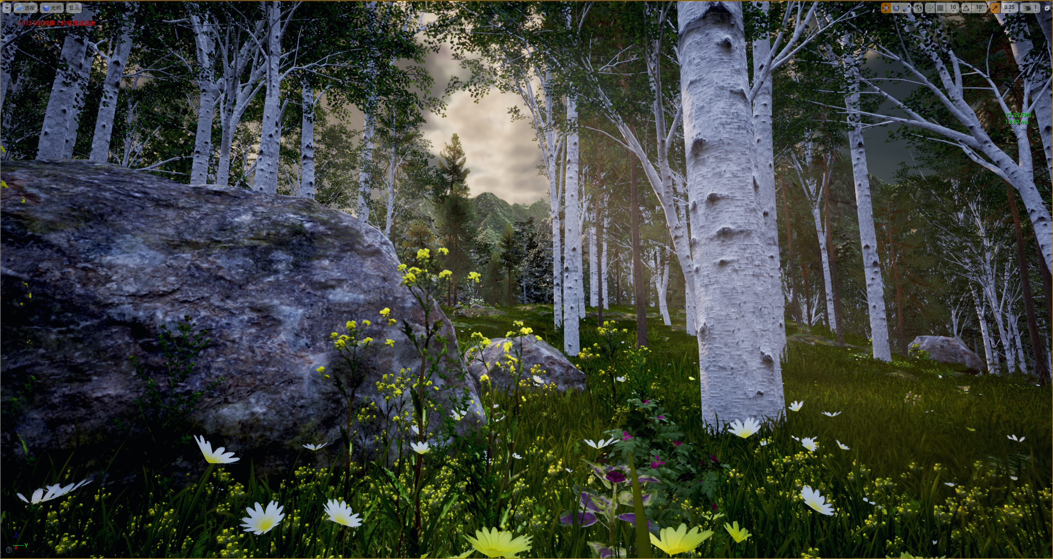
Final Scene
Figure 13.1 Final Scene
Notes:
The project has been basically completed after adding all the components.
However, there is one more thing…

Slide 15
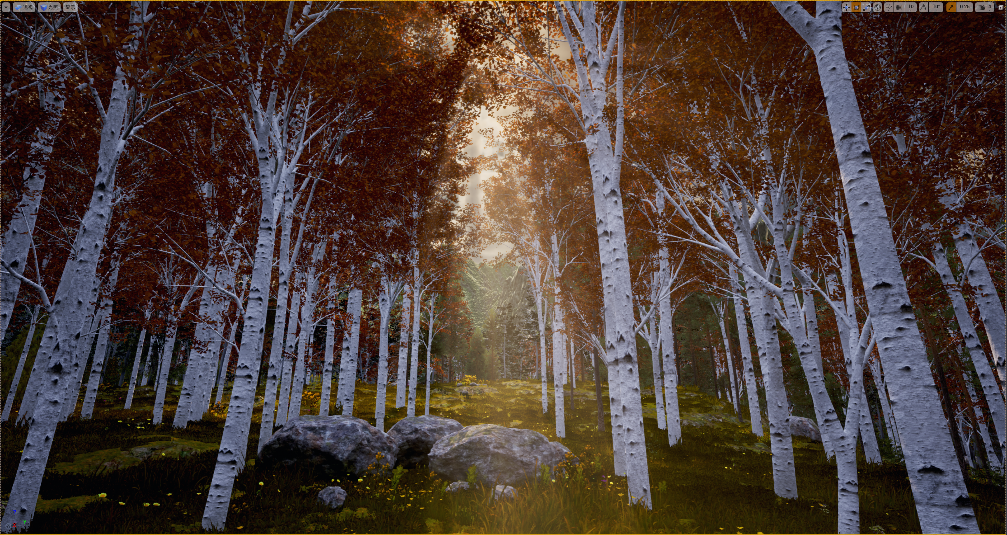
Highlight: Colorful Mountain - Wucaishan
Figure 15.1 Wucaishan
Notes:
Wucaishan是大兴安岭秋季有名的景色之一，在秋季，不同植物有着不同的叶子颜色，在一座山上可以看到数种不同的颜色，共同组成了艳丽的风景。英文为“Colorful Mountain”。
在本项目中，他被作为秋季加入到场景中。
秋天的场景与其他季节不同，会改变：
树叶、草地的base color
后处理的色温
太阳光强度
Wucaishan is one of the famous autumn scenery in the Greater Khingan Mountain. In autumn, different plants have different leaf colors. You can see several colors on a mountain, which together form a gorgeous scenery.
The autumn scene is different from other seasons
It changes base color of leaves and grass, the camera color temperature and also the sunlight intensity.

Slide 16
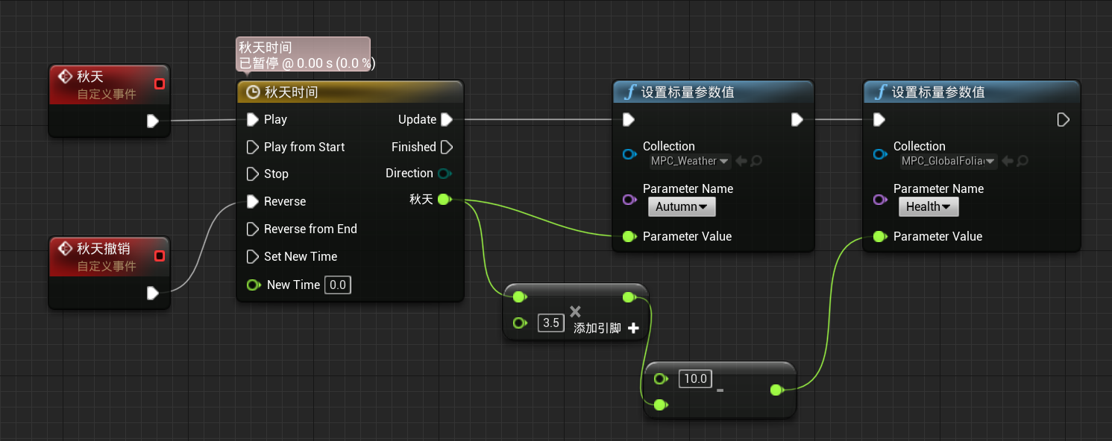
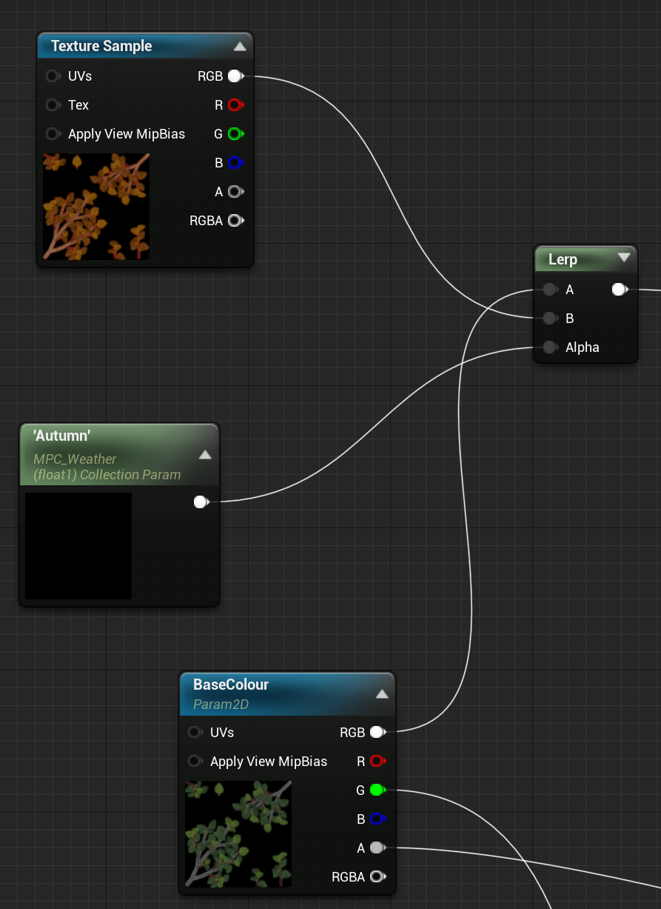

Highlight: Colorful Mountain
Figure 16.1 Colorful Mountain Blueprint Control
Figure 16.2 Parameter
Figure 16.3 Material Control
Notes:
How to achieve this effect?
实现：使用参数集控制材质插值过渡，同时使用蓝图控制参数集
最终集成在天气系统全局时间轴内
Use parameter sets to control material seasonal transitions, while using blueprints to control parameter sets
And it is finally integration within the global timeline of the weather system

Slide 17
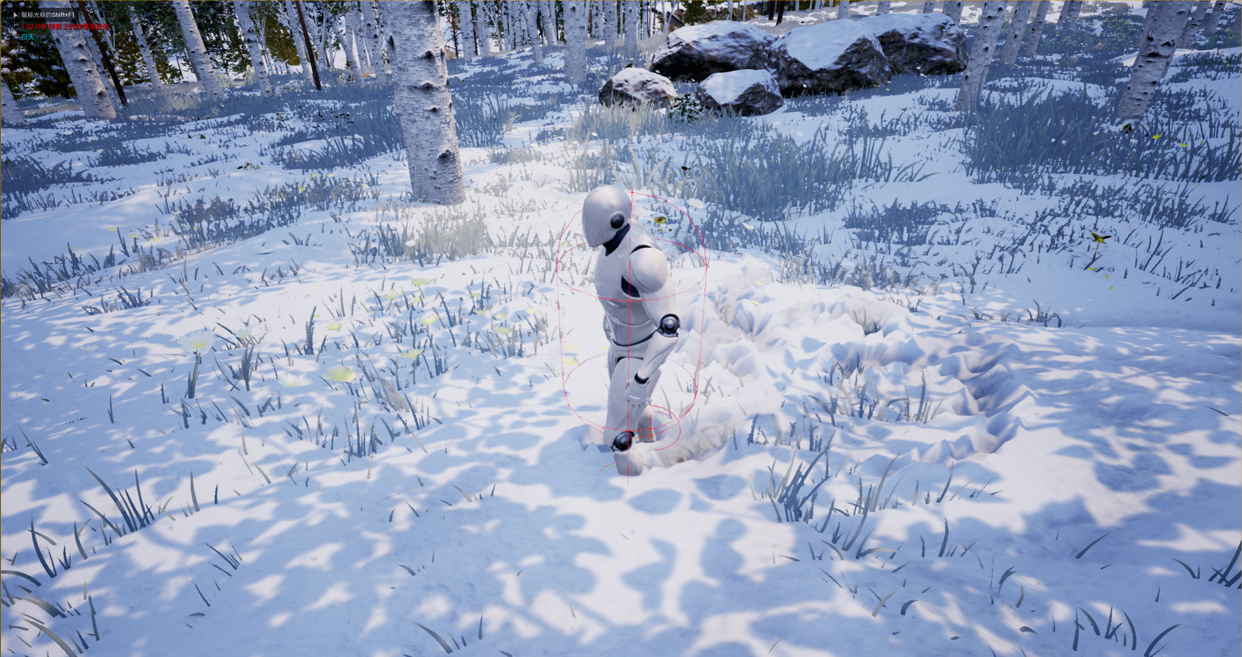
Highlight: Interactive Snow
Figure 17.1 Interactive Snow
Notes:
冬季雪景总是最能体现其寒带特征的。本研究设计亮点之一为可交互的雪。
雪地表现为：
积雪效果：下雪时雪地会自动发生堆积，堆积会发生在地表与所有模型上。
可交互：人物模型移动时会在雪地留下动态轨迹。
The second highlight of my project
The snow scene in winter always best reflects the characteristics of the cold zone. One of the design highlights of this study is the interactive snow.
Snow has two characteristics:
⚫ Snow will automatically accumulate when it snows, and the accumulation will occur on the surface and in all models.
⚫ Interactable: When the character model moves, it will leave a dynamic trail in the snow

Slide 18
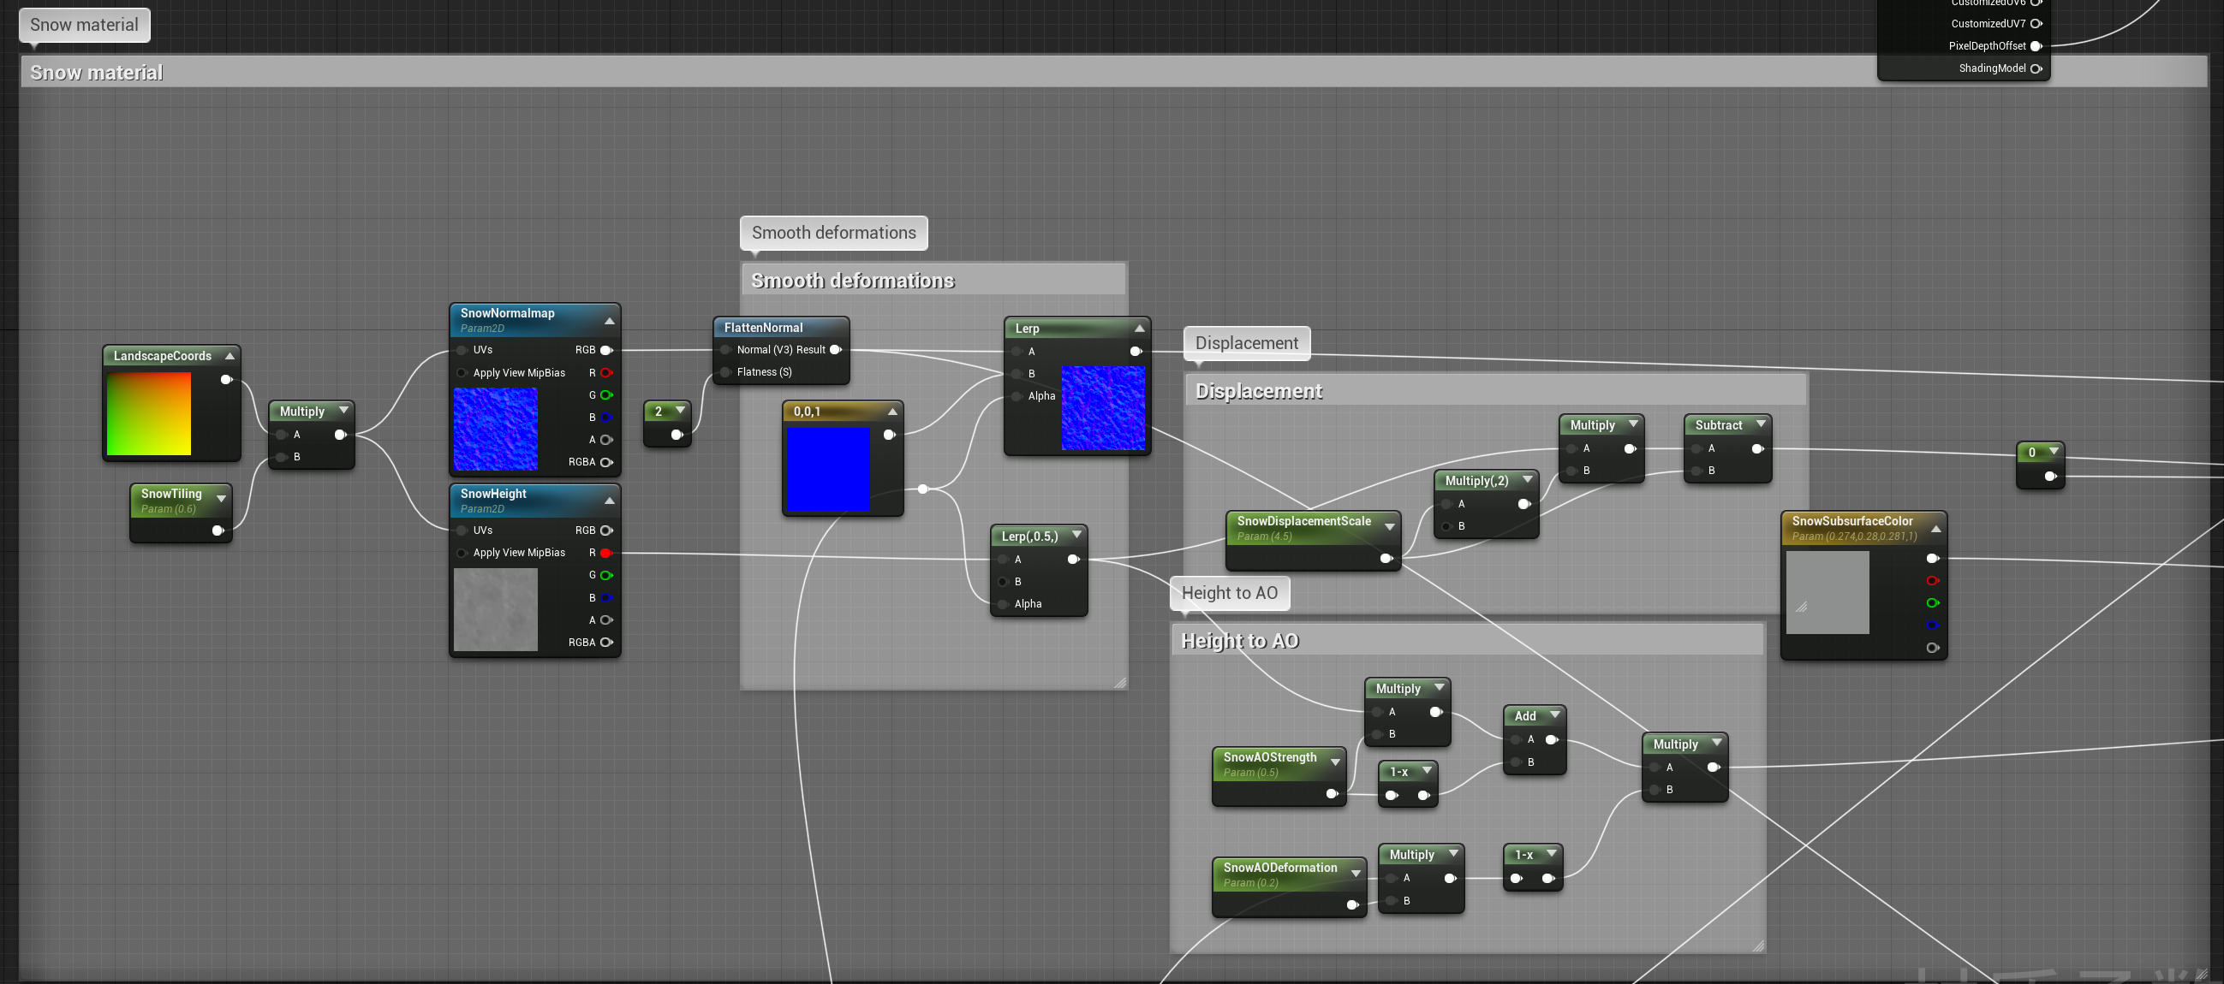
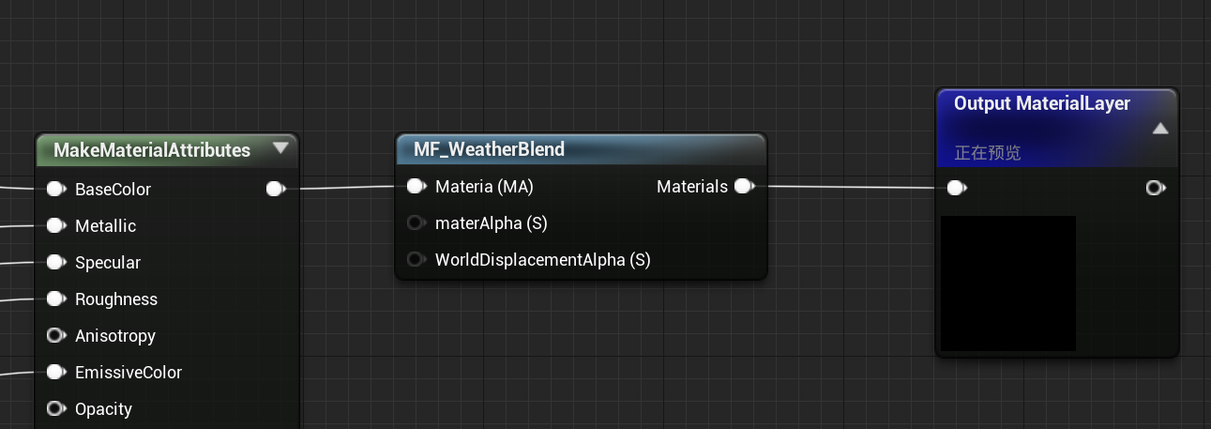
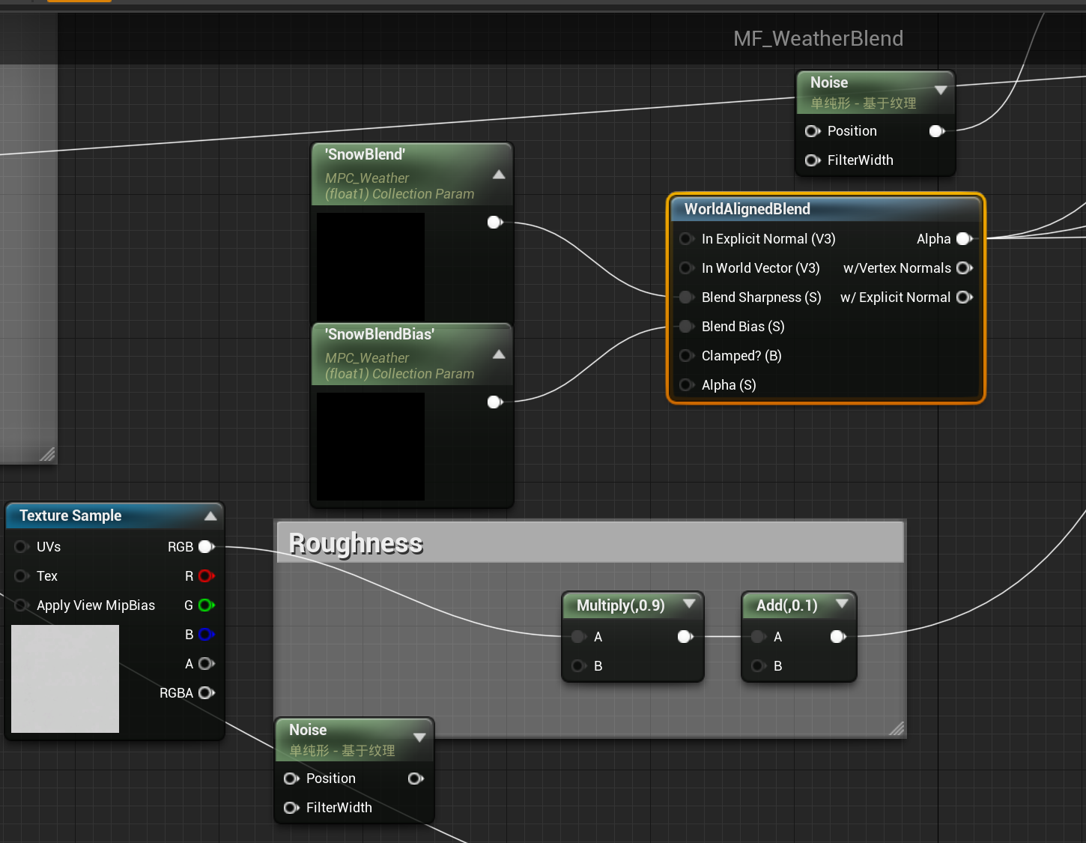
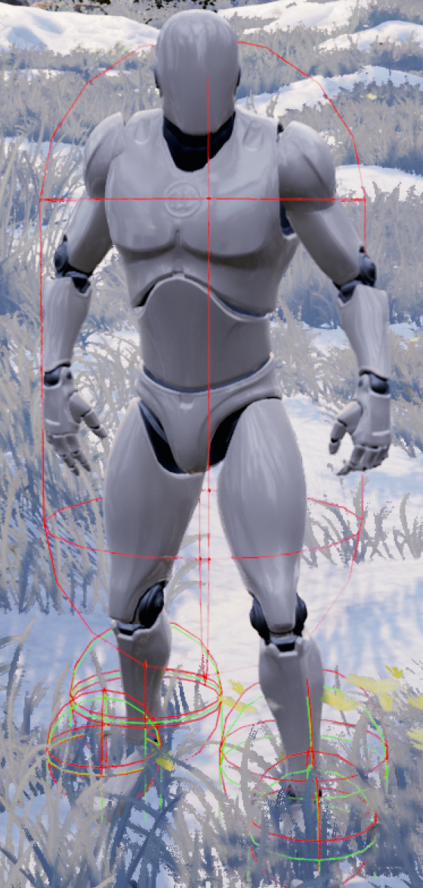


Highlight: Interactive Snow
Figure 18.2 Grass layer snow mix
Figure 18.1 Snow generating
Figure 13.5 Trail collector for character models
Figure 13.4 Tag
Figure 18.3 The realization of snow effect
Notes:
实现：首先提前混合雪图层在所有图层上，实现雪地堆积效果；随后设置人物模型采样点，人物轨迹采集反馈给图层，图层根据人物轨迹进行蒙版，消除雪图层。
First, mix the snow layers on all layers in advance to realize the snow accumulation effect;
Then set the character model sampling points, the character track collection and feedback to the layer, the layer is masked according to the character track, and the snow layer is eliminated.

Slide 19
Discussion & Further Work
Discussion:
How to Efficiently Produce Large-World Natural Environments in Unreal Engine
Based on the ProceduraLFoliageSpawner component that comes with native UE
The overall process complexity is low
China has magnificent natural scenes, and I very much hope to put China's unique natural landscapes into a unique next-generation game.
In this study, a boreal simulation scenario was created based on the Greater Khingan Mountains. Fully automated generation with weather, season and day and night systems.
Further Work
Virtual texture
Reduce shader complexity
Reduce scene rendering resource consumption and improve FPS
Package and Publish
Notes:
本研究提出了一种在Unreal Engine中高效制作大世界自然环境的方法，实现方案是基于原生UE自带的ProceduraLFoliageSpawner 实现的，并对其进行了一些改造以适应具体场景。
相比目前比较流行的 Houdini 等方案，整体流程复杂度低，其独特优势在于基于原生 UE，而没有进行过多的改动，且植被的生成规则很容易定制和拓展。
To sum up,
This research proposes a method to efficiently create the natural environment of the big world in Unreal Engine. The implementation is based on the ProceduraLFoliageSpawner that comes with the native UE, and some modifications are made to suit specific scenarios.
Compared with the currently more popular solutions such as Houdini, the overall process complexity is low, and its unique advantage is that it is based on native UE without too many changes, and the vegetation generation rules are easy to customize and expand.
中国拥有壮丽的自然场景，我希望将中国的独特自然景观放到有特色的次时代游戏中。
China has magnificent natural scenes, and I hope to put China's unique natural scenery into a unique next-generation game.
For further work, I need to put virtual texture into my scene to further reduce shader complexity and scene rendering resource consumption to improve frame rate

Slide 20
The End !
Notes:
That’s the end of my project presentation, thank you for your listening!

